Slide 1
AlgoCart CTO home assignment – Mordechi Mor sofer
The problem: Titanic - Machine Learning from Disaster, the goal is to predict if someone would survive the titanic crash disaster by using the Kaggle database of the titanic.
My approach: after looking and analyze the database I decided to make two solutions:
The first one is based on different classifiers from sklearn library such as knn, linear regression, decision trees, etc.
The second one is using a neural network with Keras and TensorFlow. In my personal opinion, it’s not good always to run for NN. Because it’s may take a lot of resources, but in this case, we work with simple data therefore, it’s didn’t took too much.

Slide 2

About
Work hard, Question everything, and come up with creative solutions.
I am Mor an Algorithms R&D Software Engineer experienced with Computer Vision, ML and Algorithm development. The paper that I published worldwide helps companies to save billions of dollars and massive amount of time. Motivated for my next challenge in a company that is looking for a team player and quick learner to develop efficient solution to complex problem.
MS.c Computer Science in the Open University of Israel, close to end my degree with research in VR, NN and ML.
I developed a Font Recognition engine based on NN with Keras, Tensorflow and CV2 got to 94% accuracy
Done research, which was published worldwide at the FEDSM, Florida conference.
BS.c Software Engineer gradate from Jerusalem College of Technology Lev
I was Team Leader in IDF at unit 0871

Slide 3
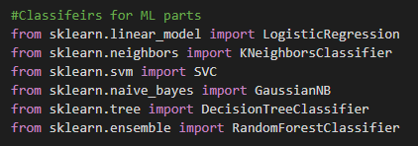

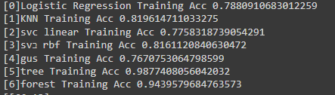

First solution, classifiers
I started by analyze the database and check for problematic values. for example, missing values, duplicates or unnecessary (like cabin numbers). In a disaster like the Titanic, the cabin's location can tell us a lot, unlike the cabin's number. After I finished all the analysis and feature-selecting I used the sklearn library to import several different classifiers for this dataset. I decided to use the most commons, and choose the best result from them
From the Confusion matrix of the result, it’s was simple to extract the score of each one of those classifiers:

Slide 4

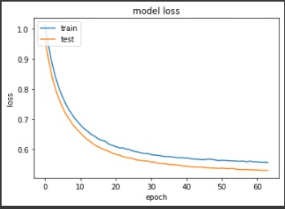
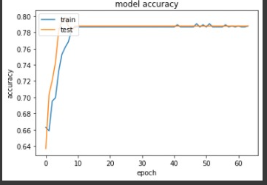
Second solution, Keras NN
The downside of using NN:
There is not enough data, and even when I checked the option of data generating I saw it’s didn’t have any significant effect.
Easy to get overfiting
Taking more time than the classifier and got a similar result.
Bzut still even when the result was similar the difference between the testing and the training accuracy wasn’t very big as we can see both of them tends towards 80%.
The model is simple model of 3 layers:
model = Sequential()
model.add(Dense(32,input_shape=(X_train.shape[1],),kernel_regularizer='l2'))
model.add(Activation("relu"))
model.add(Dense(32, kernel_regularizer='l2'))
model.add(Activation("relu"))
model.add(Dense(16,kernel_regularizer='l2'))
model.add(Activation("relu"))
model.add(Dense(1,kernel_regularizer='l2'))
model.add(Activation("sigmoid"))
model.compile(loss='binary_crossentropy',optimizer ="Adam", metrics=['accuracy'])

Slide 5
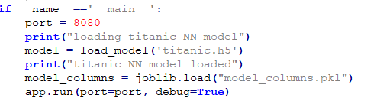
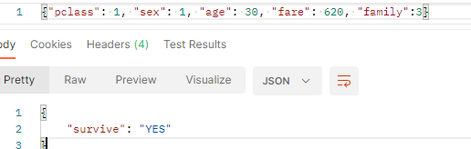
The Api
I build the API with Flask and use postman desktop to check it, after few minutes I got the API running on localhost:8080 (127.0.0.1:8080/predict)While the host was running I sent a “POST” request from the postman desktop:
Features explanation:
Pclass – the class the passenger was (first, second or third)
Sex – 1 indicate male, 0 indicate female (auto-generate by labelencoder)
Age – the passenger age
Fare – the passenger fare
Family – how many family members are on the board with him.
I used this value instead of SibSp and Parch because
when we removed them the result gets very low, therefore instead of
getting two duplicate values about family members I combined them.

Slide 6
Inconclusion
Both of the solutions have a similar result and are fast to execute.
Classifiers are maybe simpler give good resources if we want a simple and fast solution.
NN is taking a little longer than the classifier. Still, our case doesn’t deal with images or huge data therefore the computing power and running time it takes are lows. It takes less than one minute for the model to run.
NN have an advantage, the training and testing accuracy and loss don’t have such a gap between them as the classifier.
Although NN take more time because both tend towards 80% without such a drop from the train and the test accuracy I decided to go with the NN model.
About the data:
When I analyze the data I found few interesting things:
Females have higher survival rates than males.
Those who come with bigger families have lower survival rates.
The database is really small which can cause overfitting fast.
There are a lot of missing values that are set to null, I decided to take random values, considering the given values.

